Slide 1
Traffic Analysis of Medium and Heavy-Duty Vehicles in the Inland Empire
Presented by –
Bhavik Khatri, CSUSB
Sai Kalyan Ayyagari, CSUSB

Slide 2
Agenda
Introduction
Definitions
Area of Study
Data Source
Sample Size
Results
Discussion
Future Work

Slide 3
Introduction

Slide 4
Introduction
Inland Empire (IE): Population: 4 million, Area: 27,000 sq. mi.
Impact of logistics industry
IE sustainability
Electrification of medium and heavy-duty trucks
Opportunity charging

Slide 5
Definitions

Slide 6
Definitions
Sub-Regions – 6 main city clusters of the Inland Empire
Buffer – Approximately 130 miles radius from the 6 sub-regions
Medium-Duty (MD) – Class 4 to Class 6 vehicles
Heavy-Duty (HD) – Class 7 to Class 13 vehicles
Regional/Short Hauler – MD & HD truck trips within the 130 miles buffer
Long Hauler – MD & HD trips beyond the 130 miles buffer

Slide 7
Area of Study

Slide 8
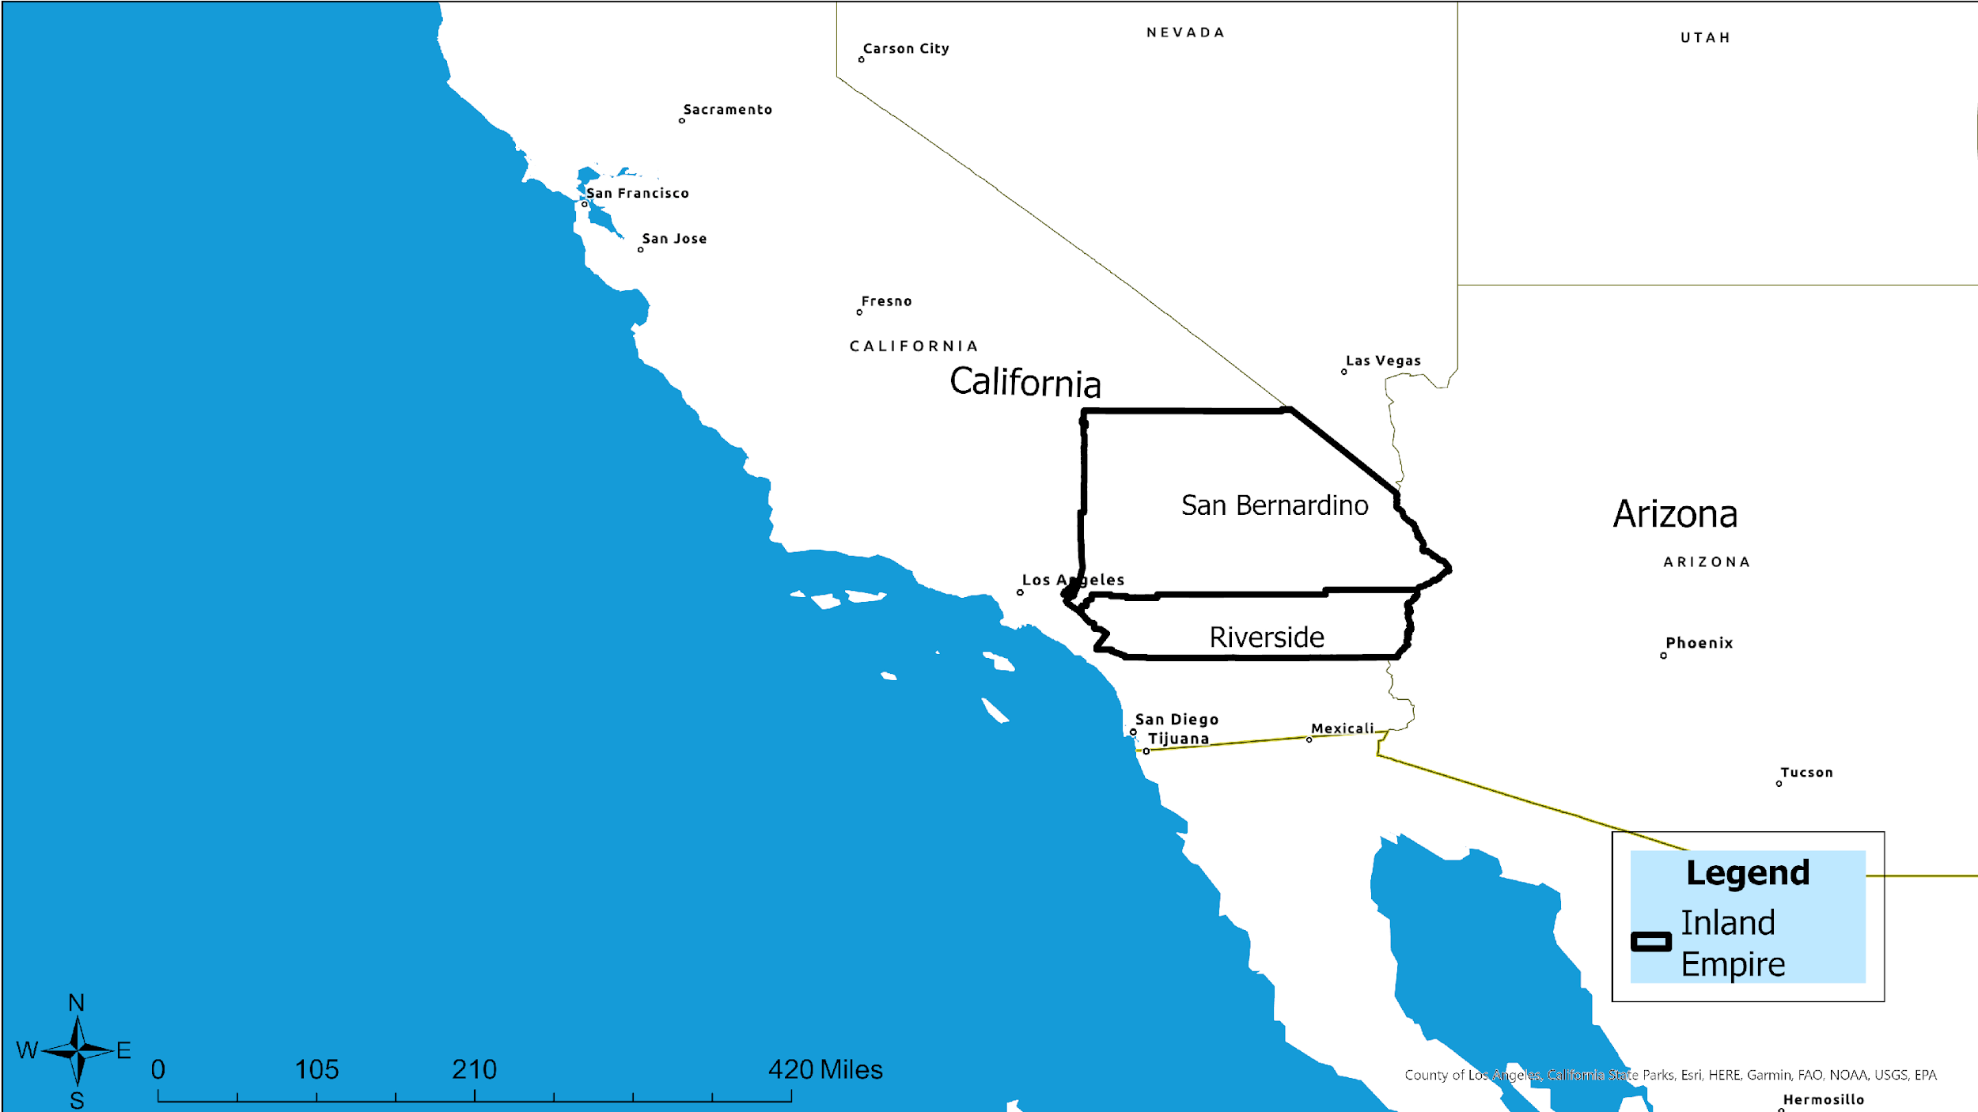
Inland Empire Region

Slide 9
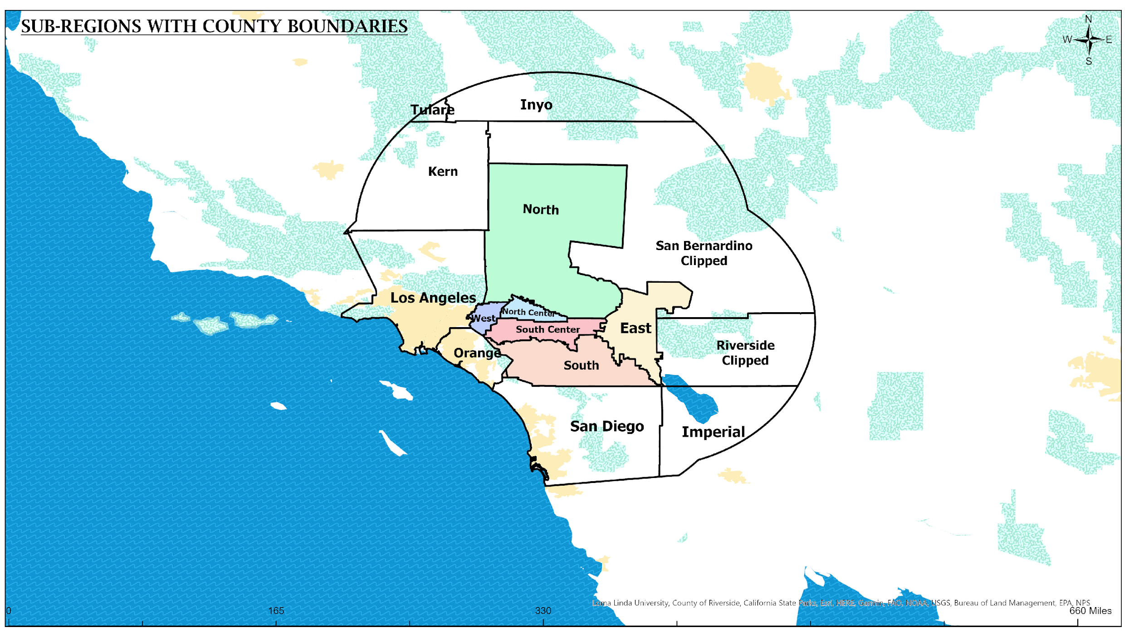
Buffer Zone Map: Convergence of Six Sub-Regions

Slide 10
Cities of the Sub-Regions
East Region | North Region | North Center Region | South Region | South Center Region | West Region
Coachella Valley Area | High Desert Area | San Bernardino & nearby cities | Temecula Area | Riverside & nearby cities | Ontario, Rancho Cucamonga & nearby cities
Twentynine Palms | Victorville | Yucaipa | Murrieta | Calimesa | Chino Hills
Yucca Valley | Adelanto | Grand Terrace | Lake Elsinore | Norco | Rancho Cucamonga
Indian Wells | Big Bear Lake | Colton | San Jacinto | Beaumont | Montclair
La Quinta | Barstow | Redlands | Wildomar | Riverside | Upland
Desert Hot Springs | Hesperia | Rialto | Canyon Lake | Corona | Chino
Rancho Mirage | Apple Valley | Fontana | Perris | Banning | Ontario
Cathedral City |  | Highland | Menifee | Moreno Valley | Claremont
Indio |  | Loma Linda | Temecula | Eastvale | Pomona
Palm Springs |  | San Bernardino | Hemet | Jurupa Valley
Palm Desert
Coachella

Slide 11
Data Source

Slide 12
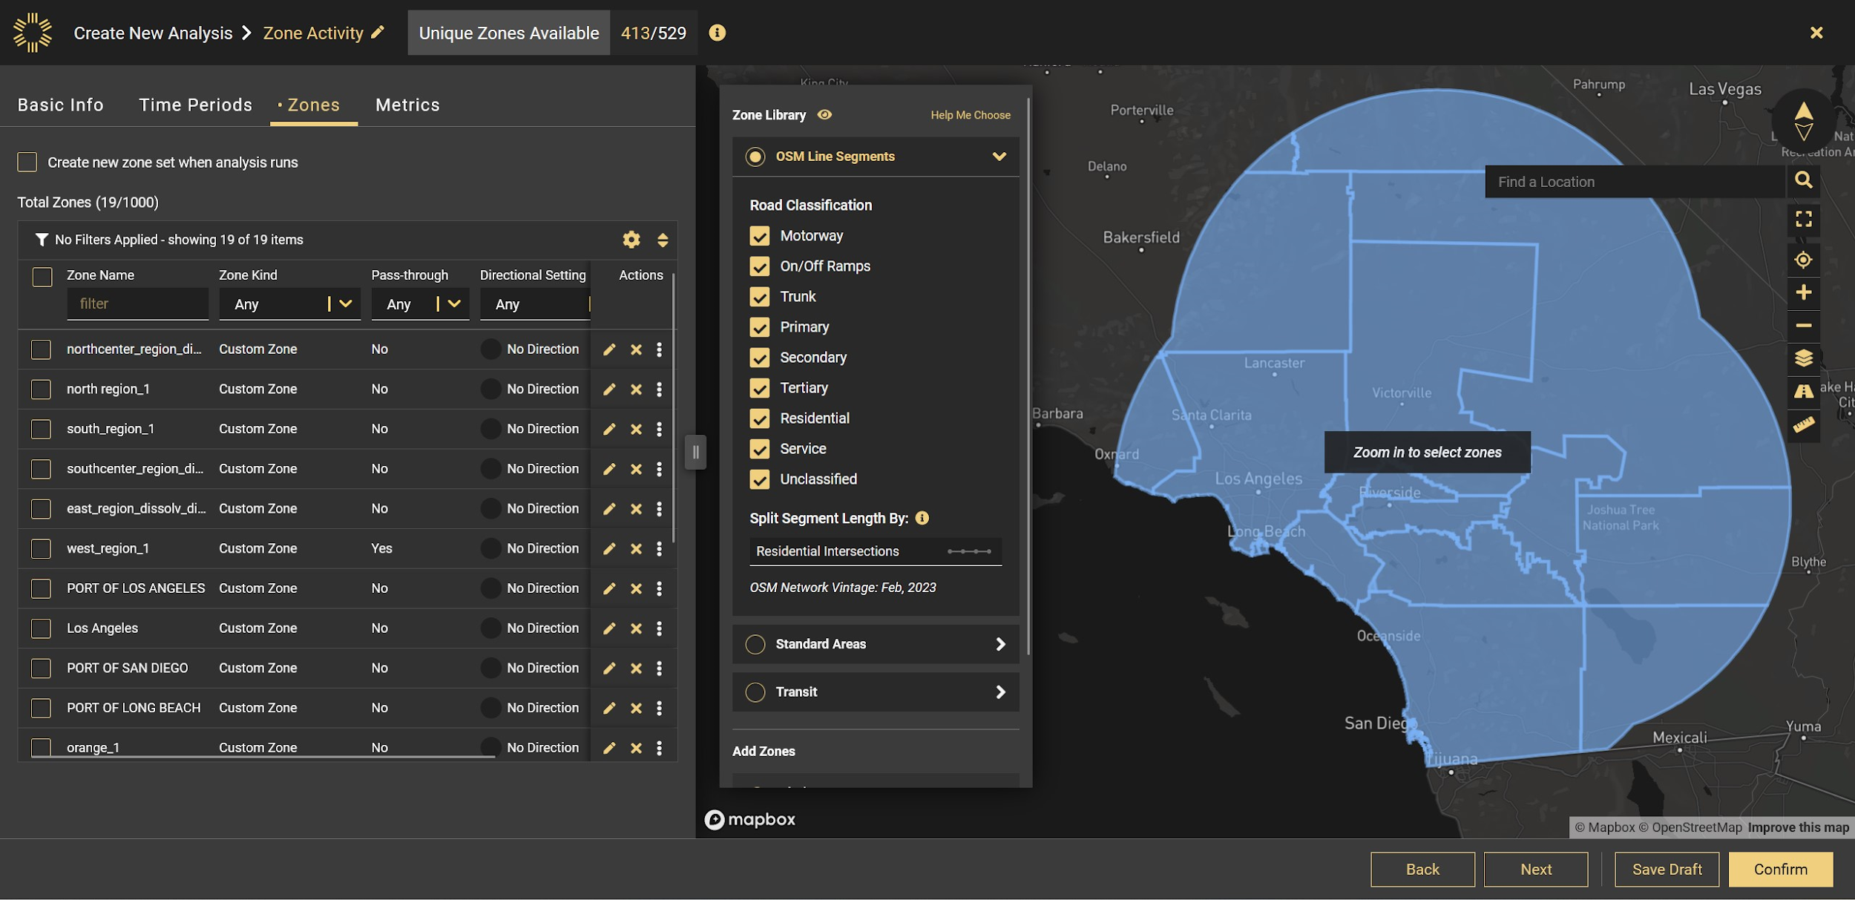

Slide 13
Sample Size

Slide 14
Sample Size
Truck Type | Approximate Trip Count
Medium Duty | 2,200,000
Heavy Duty | 1,800,000

Slide 15
Results

Slide 16
Traffic Volume

Slide 17
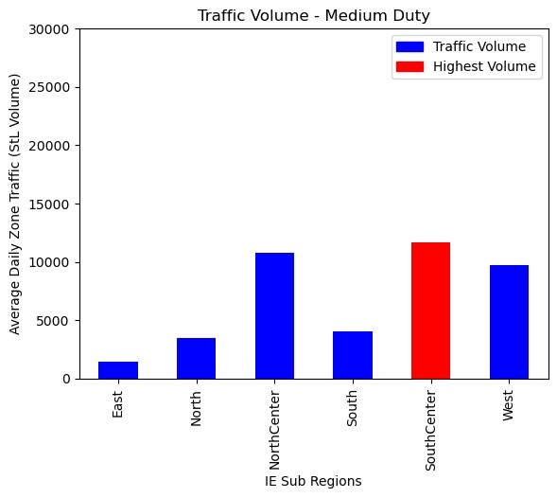
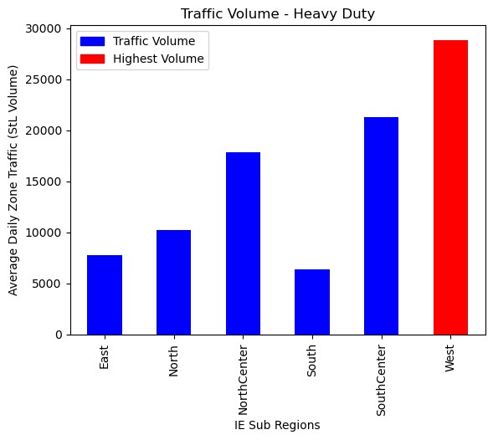
Traffic Count – Trucks passing through Sub-Regions - 2021

Slide 18
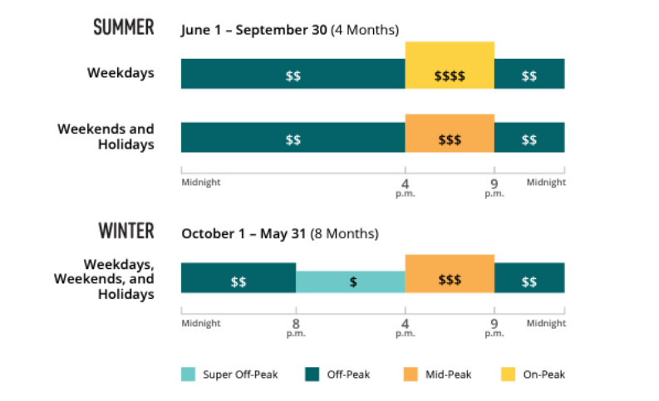
EV Charging Costs based of Time of Use Periods
Source: SoCal Edison

Slide 19
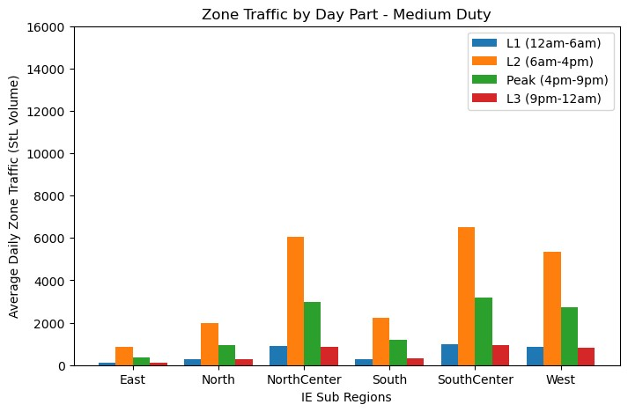
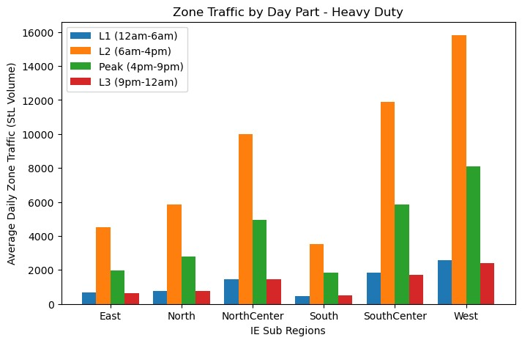
Traffic Count by Hour Segments - 2021

Slide 20
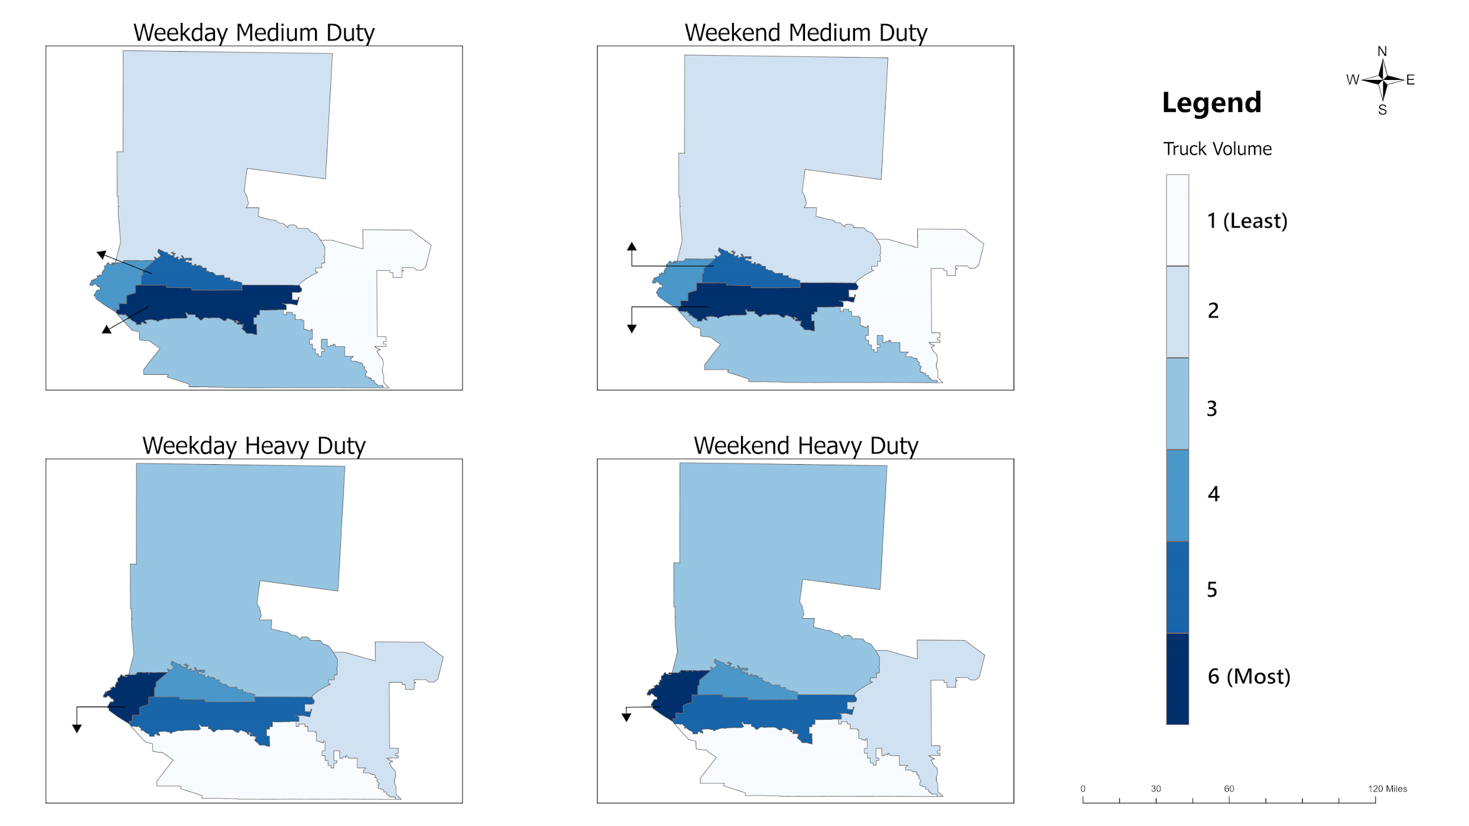
North
8.4
(in %)
North
8.45
North Center
26.36
North Center
26.19
West
23.84
East
3.52
West
23.47
East
3.55
South Center
28.44
South
9.57
South Center
27.93
South
10.28
Traffic Count by Day Segments - 2021
North
11.00
North
11.07
South Center
28.44
South Center
22.82
North Center
19.28
North Center
19.46
East
8.37
East
8.44
West
31.39
South
6.7
West
31.05
South
7.24

Slide 21
Origin - Destination

Slide 22
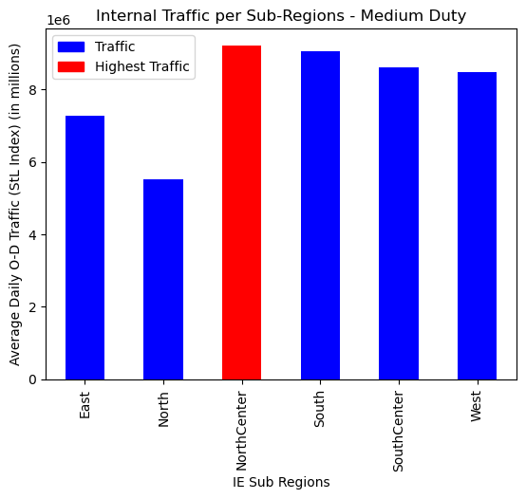
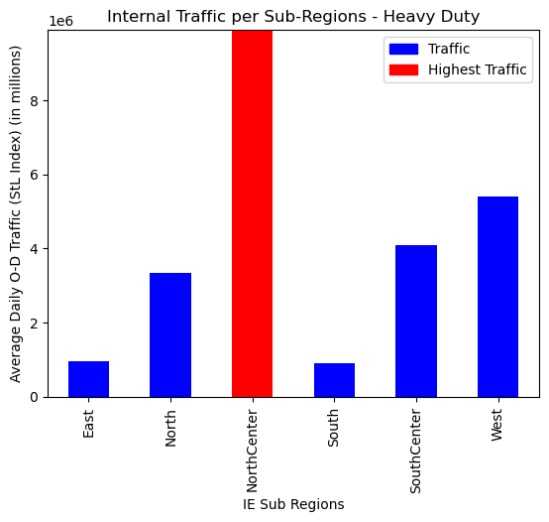
Internal Traffic per Sub-Regions
13 million

Slide 23
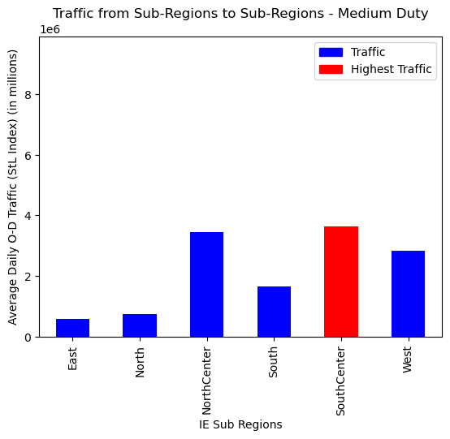
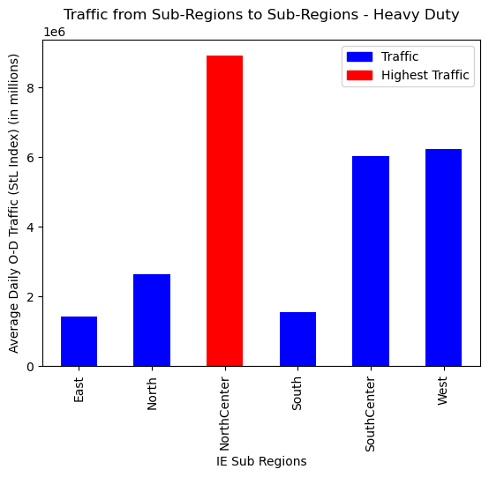
Traffic from Sub-Regions to Sub-Regions

Slide 24
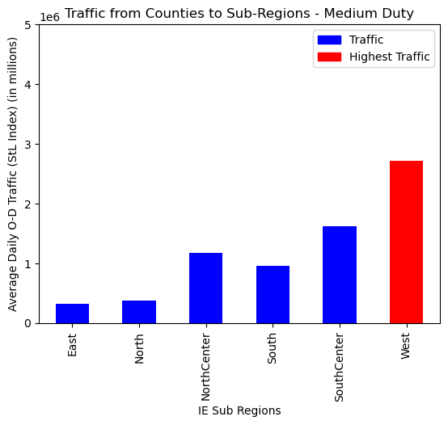
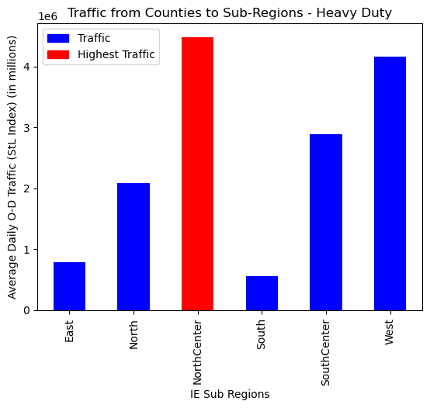
Traffic from Counties to Sub-Regions

Slide 25
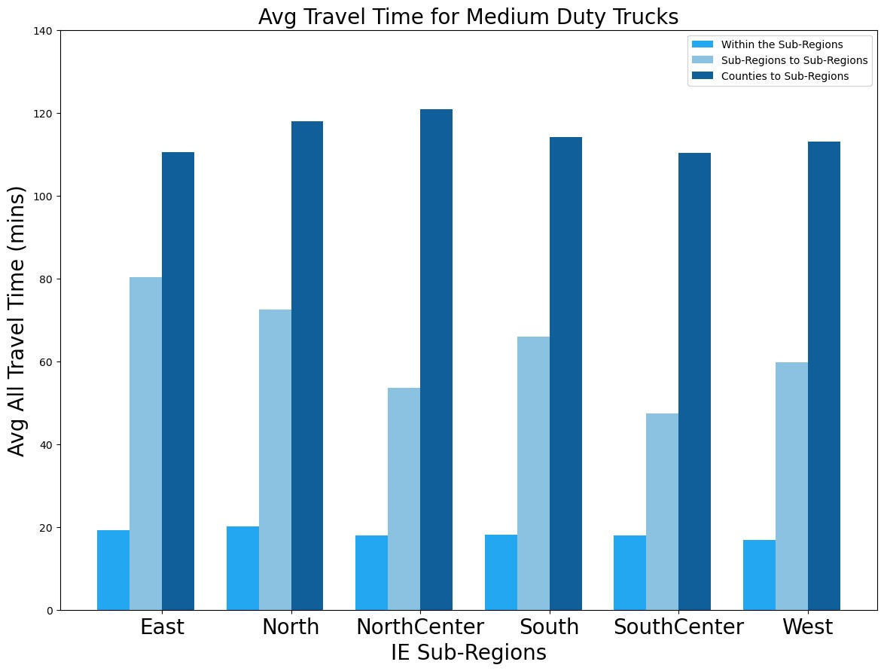
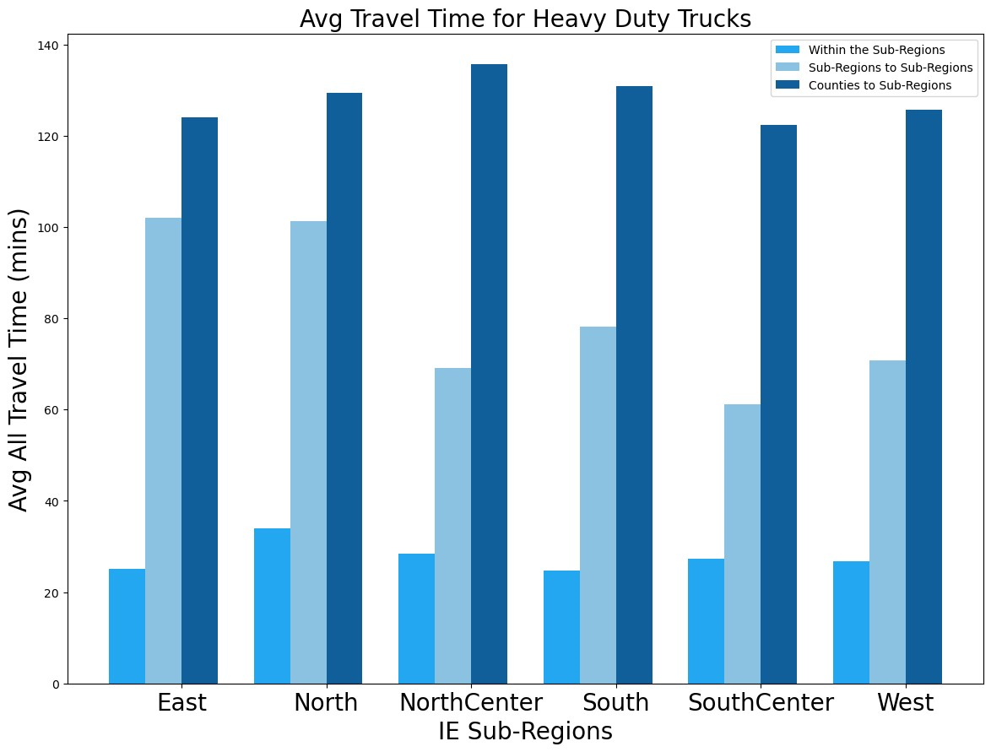
Average Travel Time

Slide 26
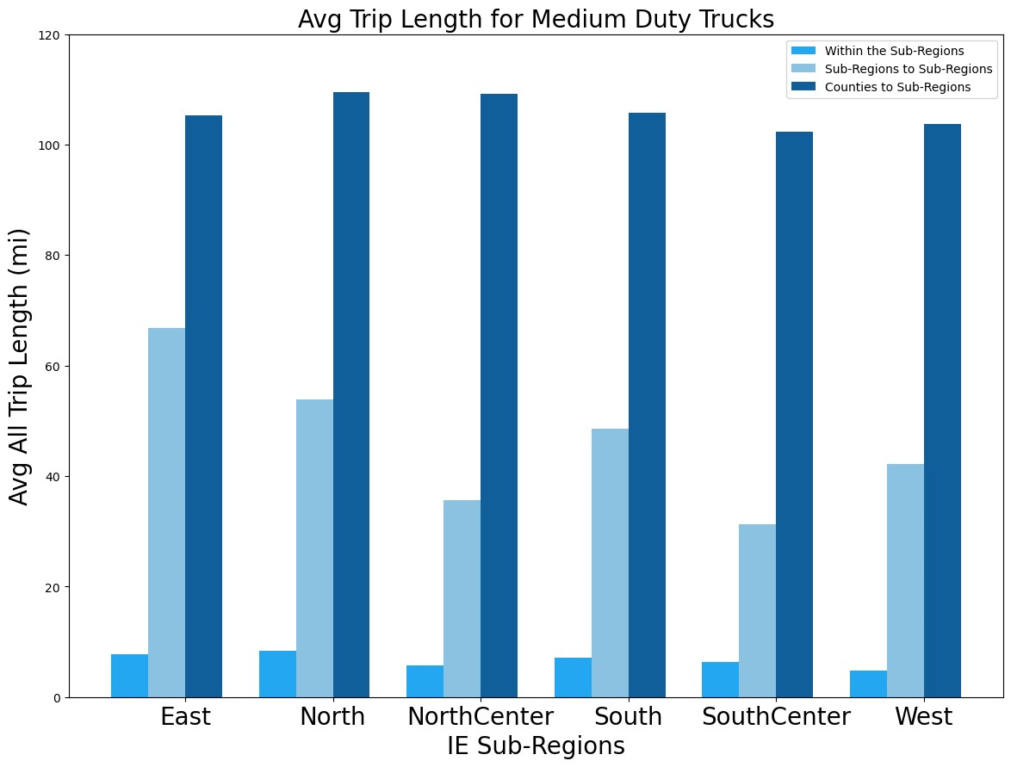
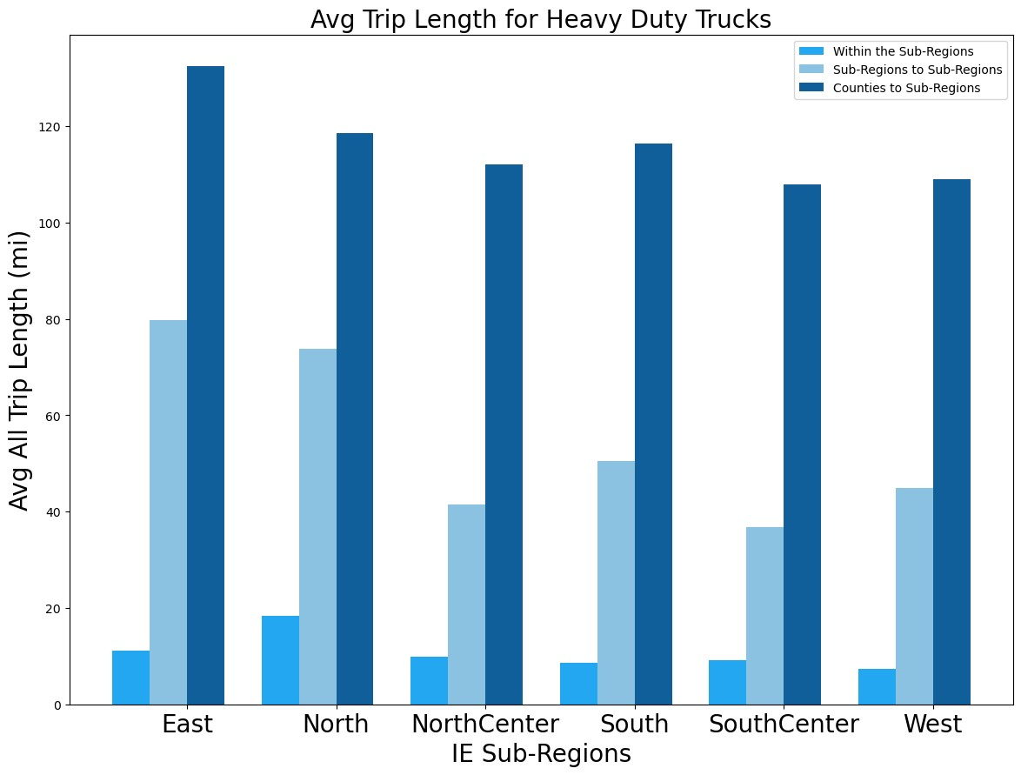
Average Travel Distance

Slide 27
Discussion

Slide 28
Discussion
The traffic volume for heavy-duty vehicles is substantially higher (x2.25) than medium-duty vehicles for the 6 sub-regions.
Most of the truck traffic is between 6AM – 4PM approximately 60% of average daily traffic for the 6 sub-regions.
San Bernardino and its neighboring cities receive the highest percentage of Heavy-Duty truck traffic from the Inland Empires’ other subregions and neighboring counties.
Medium duty truck traffic has the highest trips within subregions.
Truck trips that are averaging 10 – 50 miles per trip favor dense charging networks and smaller batteries, while trips averaging upto 140 miles require extensive fast-charging stations and larger batteries.
Truck trips that are averaging 10 – 50 minutes can benefit from off-peak use and frequent charging, whereas trips averaging upto 2 hours require efficient charging and inter-regional coordination.

Slide 29
Future Work

Slide 30
Future Work
Opportunity Charging Policy Analysis and Business Models

Slide 31
Thanks to the LTC team and the SB1 CSU Transportation Center
Any Questions ?

